Slide 1
EY | Better Working World
Team: Obtuse Angle
Xinbo Ye

Slide 2
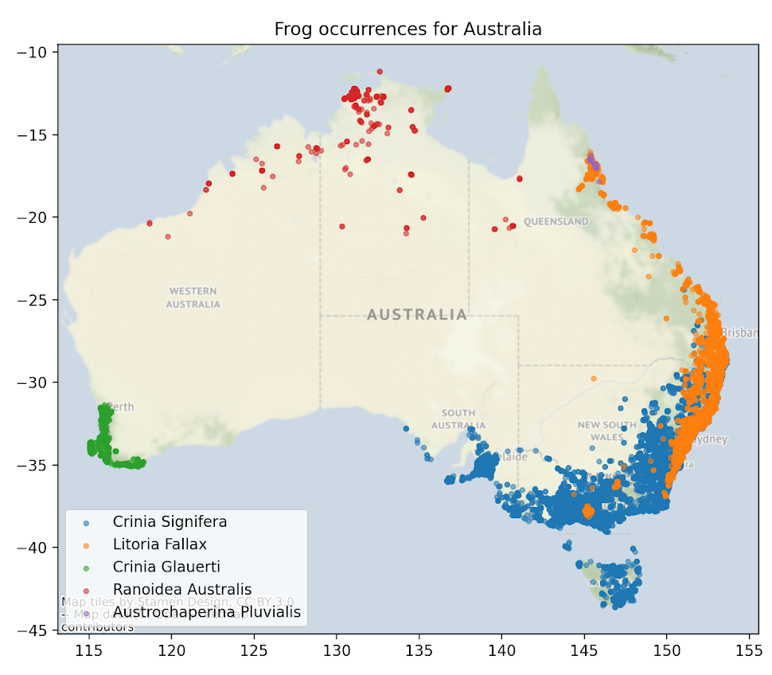
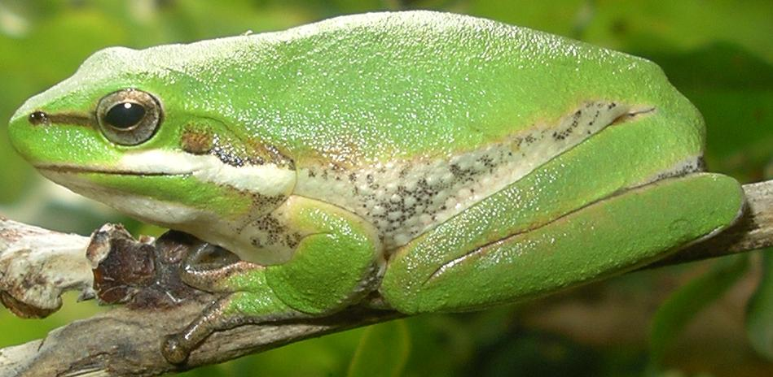
Background
Identify Litoria Fallax against other frogs.

Slide 3
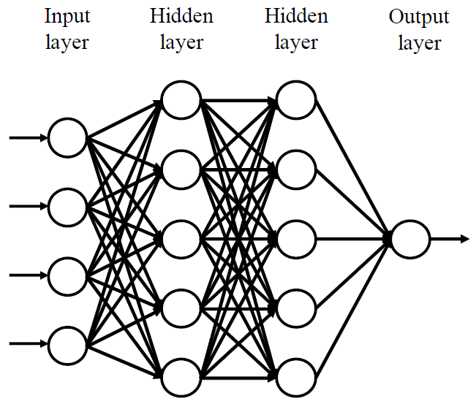
Model
'tmax'
'tmin'
'ws'
'aet'
'def'
'pet'
'vap'
'pdsi'
'srad'
0: Not occur
1: Occur
Features
Source: https://kobiso.github.io/

Slide 4
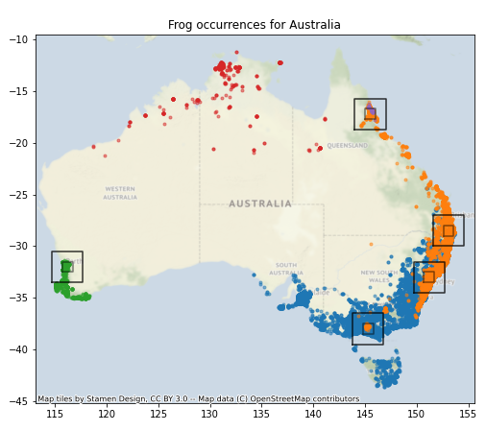
Sampling
Spatial sampling
Temporal sampling

Slide 5
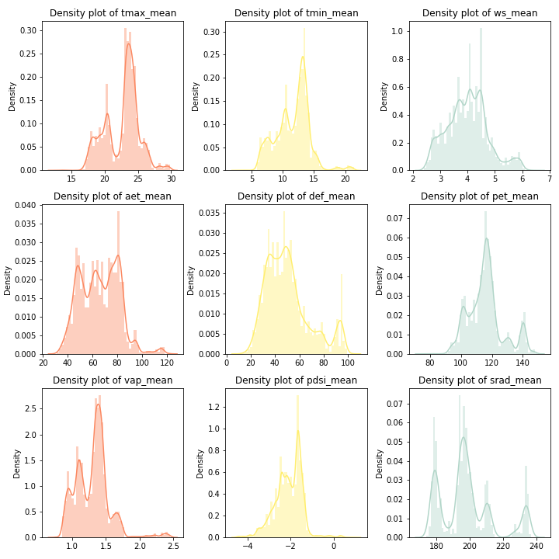
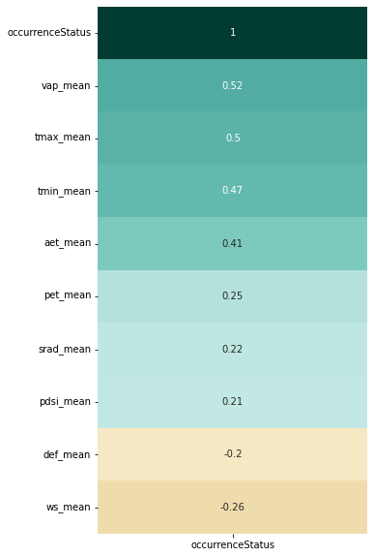
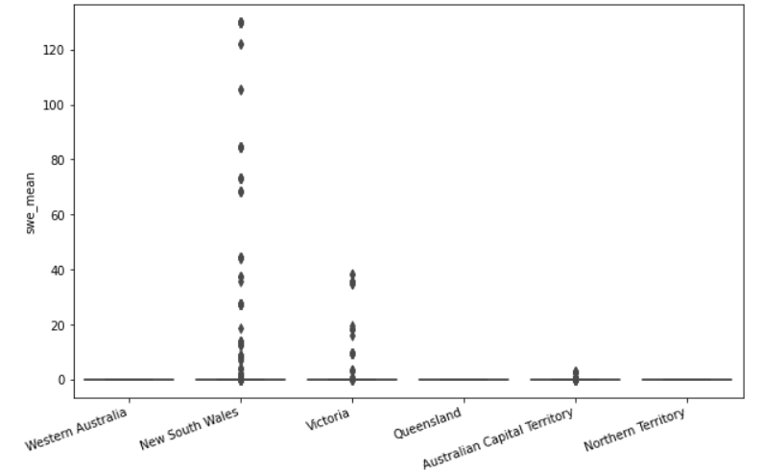
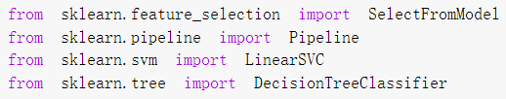
Feature Selection
Pearson Correlation
Visualization
Model Based Feature Selection
(SVC, Decision Tree)

Slide 6
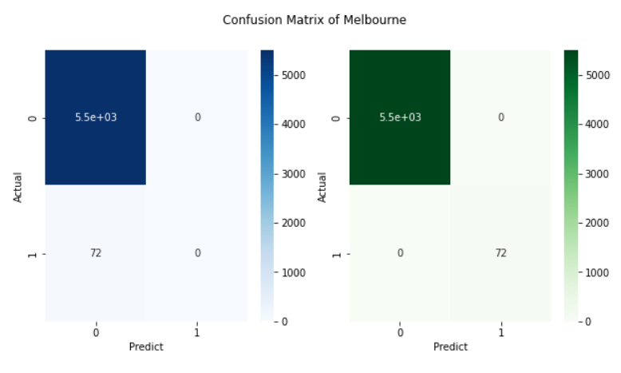
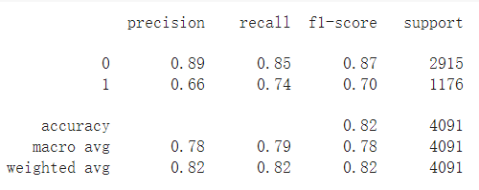
Model Results
Overall Model Performance
Class Imbalanced Problem

Slide 7
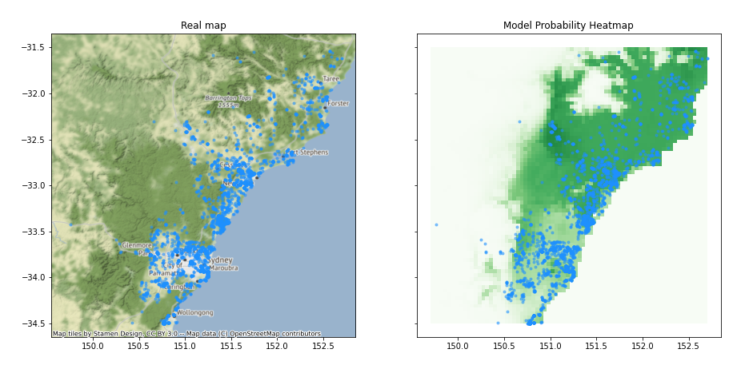
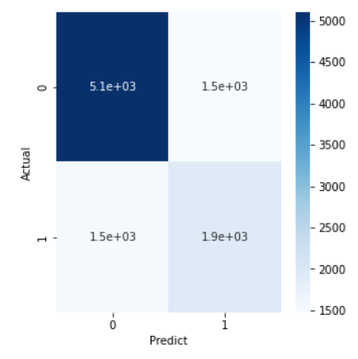
Model Results

Slide 8
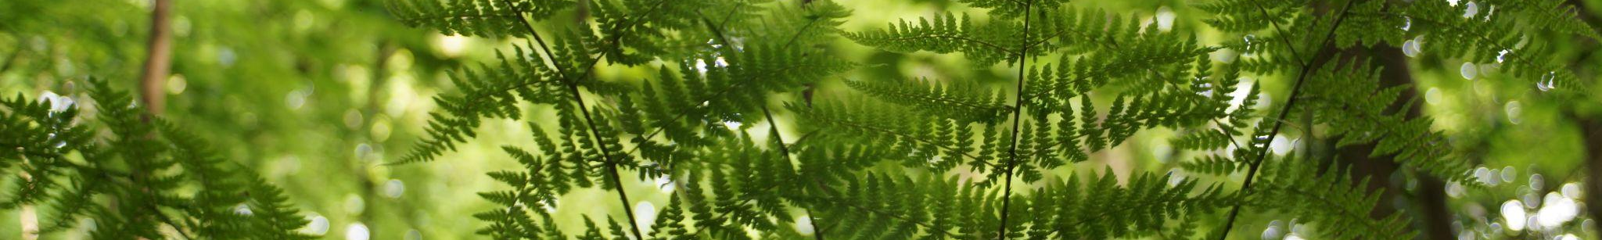
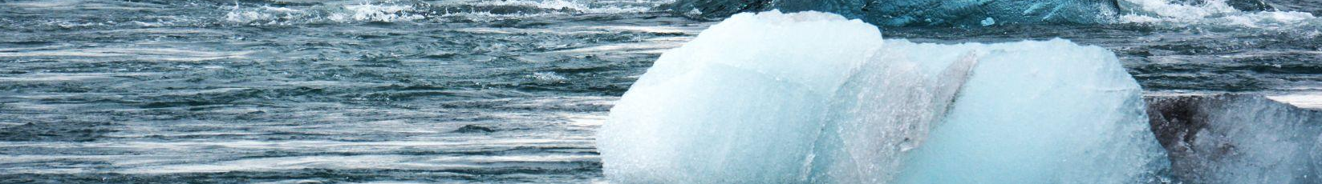
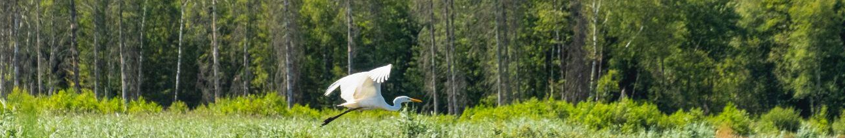
Application
Identify regions most in need of biodiversity protection.
Monitor biodiversity and climate change through prediction.
Work with weather forecasting system to protect endangered species

Slide 9
Thank you
2022.6.11

